Slide 1
Basics of Mosfets
Enes AYAZ

Slide 2
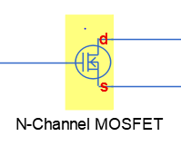
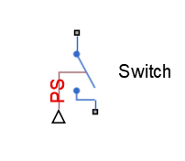
MOSFET(Metal Oxide Semiconductor Field Effect Transistor)
Transistor is used for amplifiying or switching electronic signals.
There is a 3 terminals.
GATE
SOURCE
DRAİN

Slide 3
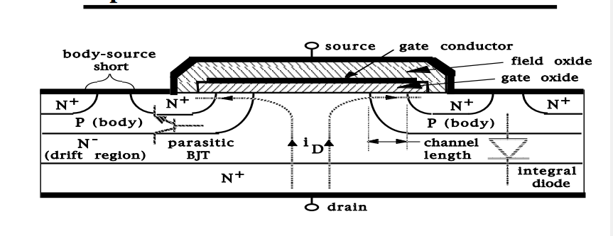
Geometries of MOSFETS
There is some manufacturing technologies to produce Mosfets.
LDMOS,VMOS,UMOS,PLANAR,TrenchMos,HexFet
VDMOS is shown above.
Basic structure is n+pn-n+ doping.(n type enhancement)

Slide 4
Working Principles and Operation Regions
Gate-to-Source voltage and Drain-to-Source voltage determines the operation of Mosfets.
Cut-off Region: Vgs<Vth
Id=0
Linear Region/Ohmic/Triode Region :Vgs>Vth and Vds<Vgs-Vth
Id=Kn*((Vgs-Vth)*Vds-)1/2*Vds^2))
Saturation Region: Vgs>Vth and Vds>Vgs-Vth
Id=1/2*Kn*((Vgs-Vtn)^2)

Slide 5
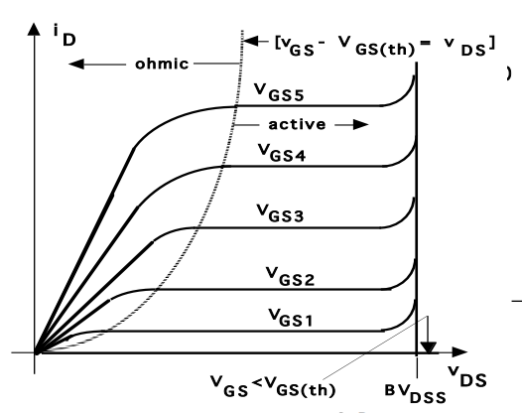
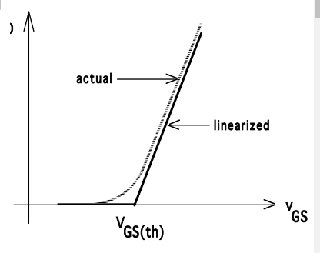
I-V Characteristics

Slide 6
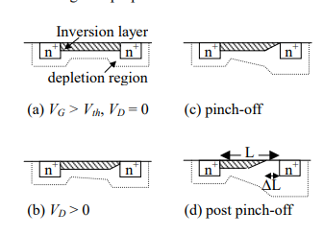
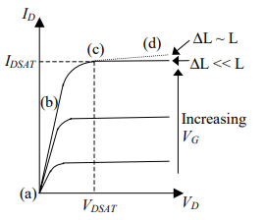
Physics of Device Operation

Slide 7
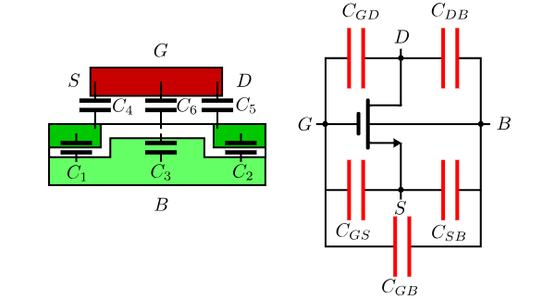
Mosfet Parasitic Capacitance

